Slide 1
Chapter 2
Quality of Life and Wellness in Hospitality and Tourism
Dr. Bendegul Okumus
Heather Linton Kelly

Slide 2
Learning Outcomes
Define and discuss the term of quality of life
Define and discuss the domains of Gross National Happiness Index (GNHI) and the World Happiness Report
Discuss why some countries have higher World Happiness Report rankings than others
Define and discuss quality of life and wellness in hospitality and tourism
Define mindfulness within hospitality and tourism context
Benefits of mindfulness to travelers
Benefits and drawbacks of mindfulness to the destination
Discuss how quality of life and wellness can be improved through hospitality and tourism
Define bleisure and discuss how hospitality and travel businesses can offer better bleisure packages.

Slide 3
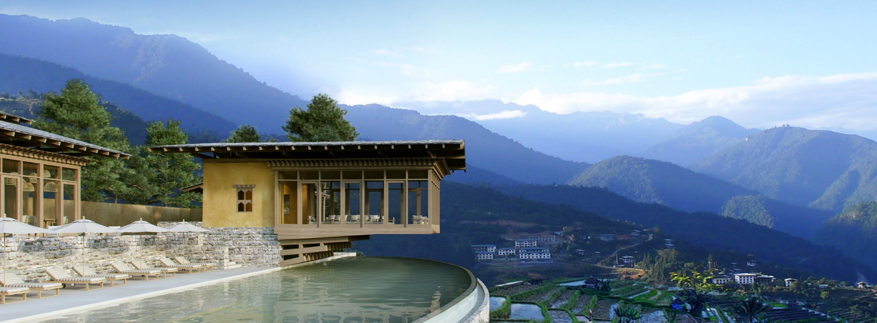

Case Study: Six Senses Bhutan
To learn more about Six Sense Bhutan, click here and here.

Slide 4

Quality of Life and Wellness
Bhutan’s Gross National Happiness Index (GNHI)
  Psychological wellbeing, health, education, time use, cultural diversity and resilience, good governance, community vitality, ecological diversity and resilience, and living standards
The UN’s World Happiness Report
  GDP per capita, social support, healthy life expectancy, freedom to make life choices, generosity, and perceptions of corruption

Slide 5
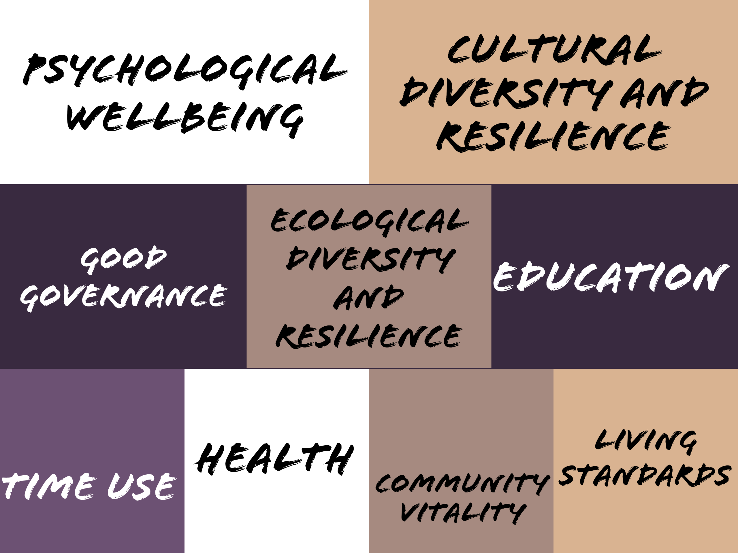
Gross National Happiness Index (GNHI)

Slide 6
World Happiness Report 2020
Ranking | Country | Score (of 10) |  | Ranking | Country | Score (of 10)
1 | Finland | 7.81 |  | 11 | Canada | 7.23
2 | Denmark | 7.65 |  | 12 | Australia | 7.22
3 | Switzerland | 7.56 |  | 13 | United Kingdom | 7.17
4 | Iceland | 7.50 |  | 14 | Israel | 7.13
5 | Norway | 7.49 |  | 15 | Costa Rica | 7.12
6 | Netherlands | 7.45 |  | 16 | Ireland | 7.09
7 | Sweden | 7.35 |  | 17 | Germany | 7.08
8 | New Zealand | 7.3 |  | 18 | United States | 6.94
9 | Austria | 7.29 |  | 19 | Czech Republic | 6.91
10 | Luxembourg | 7.24 |  | 20 | Belgium | 6.86
World Happiness Report (2019)

Slide 7
World Happiness Report 2020
Ranking | Country | Score (of 10) |  | Ranking | Country | Score (of 10)
137 | Madagascar | 4.16 |  | 146 | Yemen | 3.53
138 | Egypt | 4.15 |  | 147 | Botswana | 3.48
139 | Sierra Leone | 3.92 |  | 148 | Tanzania | 3.48
140 | Burundi | 3.78 |  | 149 | Central African Republic | 3.48
141 | Zambia | 3.76 |  | 150 | Rwanda | 3.31
142 | Haiti | 3.72 |  | 151 | Zimbabwe | 3.30
143 | Lesotho | 3.65 |  | 152 | South Sudan | 2.82
144 | India | 3.57 |  | 153 | Afghanistan | 2.57
145 | Malawi | 3.54
World Happiness Report (2019)

Slide 8
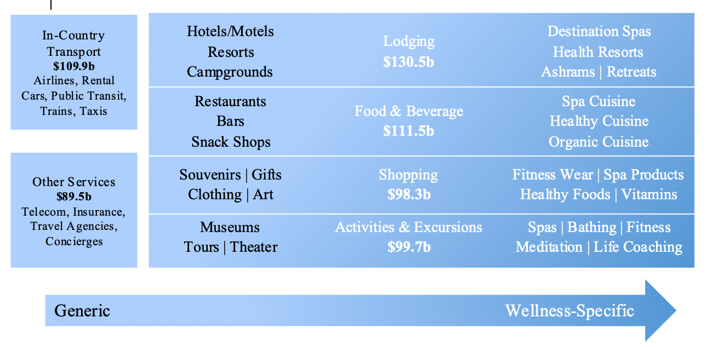
Quality of Life and Wellness in Hospitality and Tourism

Slide 9

Benefits of Wellness to Guests
A major goal of a wellness trip is to return home feeling better at check-out than at check-in
A focus on wellness while traveling encourages tourists to maintain and enhance their quality of life even when out of their everyday routine
Wellness in hospitality and tourism is simply a pause in everyday life, offering an opportunity to relax and return to daily activities in a more focused and refreshed frame of mind
Both physical and mental benefits to traveling mindfully

Slide 10
Wellness Activities in Travel
Mental: meditation, creative classes, relaxation techniques, Ayurvedic treatments, and spending time in nature
Physical: Special type of yoga, walking or running, spa treatments, mineral or hot springs, healthy cooking or dining at a local farm-to-table bistro
Develop a list of wellness activities in hospitality and tourism along a scale of budget-friendly to expensive. Develop another list of activities for low to high physical activities in hospitality and tourism.

Slide 11

Benefits of Wellness to Destinations
High-end luxury travelers are more frequently seeking wellness vacations
Younger travelers are more willing to invest in sustainable luxury travel and ethical brands than older generations
Developing markets like Africa, Asia-Pacific, and Latin America are benefiting from travelers interested in their unspoiled and still truly authentic offerings
Most locations already have some existing features to attract wellness travelers

Slide 12

Wellness Trends in Hospitality and Tourism
Individual Wellness Travel is Increasing
Demand for Flexibility in Trip Length
Higher Awareness of Value Proposition
Large Hotels Recognizing Wellness
Transformative Travel
Wellness takes on overtourism
China – Uncovering the wealth in wellness

Slide 13


TakeCare Level30
To learn more about Marriott International’s TakeCare Level30 program, click here.

Slide 14
Summary
The nine domains of the Gross National Health Index (GNHI) are psychological wellbeing, cultural diversity and resilience, good governance, ecological diversity and resilience, education, time use, health, community vitality, and living standards.
The GNHI is only used in the country of Bhutan.
The rest of the world uses the UN’s World Happiness Report.
The World Happiness Report incorporates GDP per capita, social support, healthy life expectancy, freedom to make life choices, generosity, and perceptions of corruption into its score.

Slide 15
Summary
As a part of the larger wellness economy, in 2017, lodging brought in $130.5 billion, food and beverage brought in $111.5 billion, in-country transport brought in $109.9 billion, shopping brought in $98.3 billion, activities and excursions brought in $99.7 billion, and other services brought in $89.5 billion.
Mindfulness is the practice of maintaining a nonjudgment state of heightened or complete awareness of one’s thoughts, emotions or experiences on a moment to moment basis.
Focusing on wellness during travel can be beneficial to both the traveler and the destination they are visiting.

Slide 16
Summary
Bleisure is the practice of combining business travel and leisure into one trip.
Younger generations are more likely to invest in sustainable luxury travel brands than older generations which can help combat overtourism. These brands and locations can appeal to these groups through wellness tourism.
Some wellness trends in hospitality and tourism include: individual wellness travel increasing, demand for flexibility in trip length, higher awareness of value proposition, large hotels recognizing wellness, transformative travel, wellness takes on overtourism, and China – uncovering the wealth in wellness.

